Slide 1

Intro to Node.js
Andrew Krause, La Crosse Area Developers Club, 2024

Slide 2

About Me
Software Developer at Kwik Trip
Began looking into Node.js in college (2022)
Currently building a website using Node.js as part of my learning
Notes:
Work at Kwik Trip as a Software Developer (have been for about one-and-a-half years). Vince first introduced me to the LaX Area Developers CS Club.
I began looking into Node.js when I was in college (about two-and-a-half years ago). It was introduced to me through a web development course on the Udemy learning platform.
From that point on, I have been trying to learn more about Node.js. A way I am learning more is by creating a web application for my girlfriend.
On the right side of the slide is a picture of a website called TravelBlog that I am building through Node.js.
If we have time, we can maybe look at TravelBlog in more detail at the end. Or that can be the topic of discussion for another presentation because focus may just be want to be on some Node.js basics today.
(Timebox here to 60 seconds, maybe will go over Travel Blog more at the end.)

Slide 3

Outline of Presentation for Node.js Intro
Today, want to stick to Node.js basics:
What is Node.js
Brief History of Node.js
Node.js Architecture
Simple Program (run in terminal)
Modules and Built-In Modules
Built-In Module Examples
Overview of npm
Advantages and Disadvantages of Node.js
Companies that use Node.js
Questions?
Resources for Further Learning
Notes:
Describe outline of presentation.
We will discuss what Node.js is and talk a little bit about the history of it.
We will briefly discuss the Node.js architecture and then run a simple program using Node.js.
We will discuss modules, built-in modules, and run through some simple examples.
We will talk briefly about npm.
We will talk about advantages and disadvantages of Node.js.
We will look at some companies that use Node.js, and then anyone can ask any questions they may have.
We can wrap up the presentation by going over some resources for future learning.
At any point if you have a question, feel free to jump in and ask your question or add your own input.

Slide 4
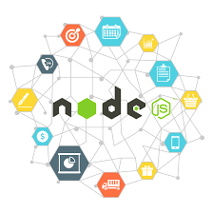
What is Node.js?
Not a programming language
Runtime environment
What is a runtime environment?
Notes:
Node is not a programming language. People often incorrectly think of it as a language (I have as well) and compare it to languages like C# or frameworks like ASP.NET Core.
ASP.NET Core and other frameworks are used for building web applications. JavaScript frameworks built on Node.js like Express.js are used to help build web applications (more on that later on).
Node.js is a runtime environment, not a framework. If you wanted to compare Node.js to something, it would be more accurate to compare it to the runtime environment of DOTNET (for C#).
So what is a runtime environment?

Slide 5
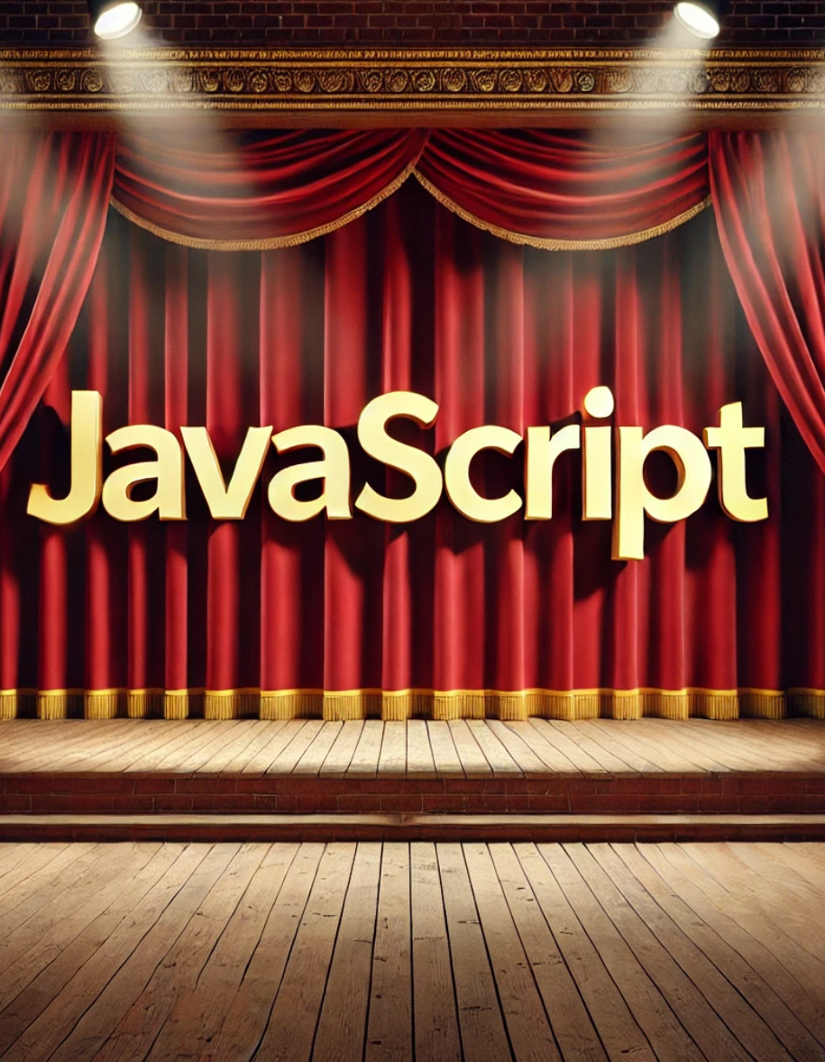
Node.js: Runtime Environment for JavaScript
Software infrastructure
Provides services to programs during execution
Runtime environment as a theater analogy
What Node.js is used for
Notes:
Node.js is a runtime environment that allows you to run JavaScript on a server. With Node.js, you can run the JavaScript outside of the browser where it was traditionally executed.
Before Node.js, JavaScript was run in the browser via a JS Engine. Different browsers have different JavaScript engines.
Firefox used SpiderMonkey
Microsoft used Chakra
Google used V8
In other words, a runtime environment is software infrastructure that provides services to programs during execution.
Analogy: Script of Play Being Executed on Stage in a Theater Production
Script of play is source code. But the script of the play comes to life/is executed on the stage of a theater.
Stage, lights, actors, etc. (CPU, memory, O.S, system services, etc.) interpret the script and interact to bring the story (source code) to life.
To bring script/story to life, need theater
Stage, lights, actors interpret the script/interact to bring the story to life.
Node is often used for building back-end services (called APIs)
Can power Web Apps (running in a web browser)
Can power Mobile Apps (running on a mobile device)
I have been using Node.js to help build a web application (TravelBlog)

Slide 6
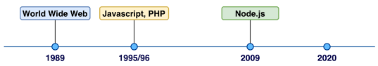
A Brief History of Node.js
World Wide Web
Javascript, PHP
Node.js
Increased usage of Node.js
npm (2010)
Notes:
1989: Tim Berners-Lee (British Scientist) credited with inventing World Wide Web (while working at CERN).
1995 : About six years later, JavaScript begins being used in the web.
Was created by Brendan Eich in 1995. He created JS in 10 days with the original intent to add a little interactivity to web pages.
2009: Ryan Dahl creates Node.js
He thought it would be great to execute JS outside the browser.
He took Google’s v8 engine, the fastest JS engine, and embedded it within a C++ program. He called this program Node.
Node.js is called "Node.js" because it represents the idea of a network "node" that can handle asynchronous events.
Node.js Documentary on YouTube that came out in 2024 that discusses how Node.js and npm came about.
2010: Isaac Schlueter (Sh-loo-et-er) releases Node Package Manager (npm)
Since 0.6.3 version of Node.js on November 11, 2011, npm has been an important part of Node.js packages.
npm important part of Node.js packages
npm is a tool that developers use to manage and share packages – important tool in web development (for JS)
npm is comprised of third-party Node.js modules that can be installed and used in Node.js-based applications
npm automatically delivered when Node.js installed
2020-2024: Today about 43% of professional developers were using Node.js frameworks, tools, and libraries (https://radixweb.com/blog/nodejs-usage-statistics)
IN SUMMARY OF INTRO AND HISTORY: Node is comprised of a program that includes the v8 JS engine plus additional modules that give us capabilities not found in the browser. For example, we don’t use document.getElementById in Node.js, we use other tools. Google Chrome and Node share the same JavaScript engine, but they are different runtime environments.
We can work with the file system
We can work with networks
And more!

Slide 7

Node.js: Architecture
Non-blocking asynchronous
Single thread to handle all requests
Architecture as a coffee shop analogy
Notes:
The architecture of Node.js can be confusing. I myself am still trying to understand it. However, it is not something you need to know the exact details of to work with Node.js. Regardless, this is a very high-level overview of it.
Image of Node.js architecture (only show if enough people ask): https://www.simform.com/blog/what-is-node-js/
Asynchronous refers to events that do not occur at the same time or do not require waiting for each other to complete. You can have events that do not require waiting for each other to complete. If JavaScript needs to wait for a given operation to complete, it can execute other code while waiting.
Node.js is asynchronous in nature so it can process things concurrently (at the same time) behind the scenes, but it always processes the results at different times. In other words, it can offload certain events to other lower-level APIs/services and process the events one-at-a-time as they come in. Behind the scenes, the lower-level APIs/services are what allow this asynchronous nature of JavaScript to exist.
Analogy (preparing breakfast) right below – synchronous vs asynchronous and single threaded vs asynchronous and multithreaded:
Synchronous: You are the cook. You cook the eggs, then you cook the toast.
Asynchronous, Single Threaded: You are the cook. You start the eggs cooking and set a timer. You start the toast cooking and set a timer. While they are both cooking, you clean the kitchen. When the timers go off you take the eggs off the heat and the toast out of the toaster and serve them.
Asynchronous, Multithreaded: You hire two more cooks, one to cook eggs and one to cook toast. Now you have the problem of coordinating the cooks so that they do not conflict with each other in the kitchen when sharing resources.
Threading is about workers; asynchrony is about tasks.
Workers: Threads, and each thread can execute a task independently and may run in parallel on different CPU cores.
Tasks: Units of work that can be executed independently
(Courtesy of web development bootcamp course and stack overflow: https://stackoverflow.com/questions/34680985/what-is-the-difference-between-asynchronous-programming-and-multithreading)
Analogy (Node.js Architecture/Event Loop): A Coffee Shop with One Barista
Customers come in and order their drinks. The customers are like the tasks or events in a program.
Instead of making a given customer wait at the counter while their drink is being prepared (this would block other customers from ordering), the barista takes each order and then calls out the customer’s name when their drink is ready.
The barista is free to take each order while the drinks are being made (asynchronously) by the other workers and/or coffee machines.
So above was a coffee shop analogy, but Node.js might handle querying a database in the following way:
Again, single thread to handle request
When database is being queried, the thread does not need to wait for the data to be returned.
While the database is executing query, thread can be used for other purposes/clients. When database prepares result, it puts a message in something called an event queue.
Node.js is constantly monitoring this event queue in the background. When it finds an event in the queue, it will take it out and process it. The result will be processed by the main thread.
Node.js’s architecture makes it ideal for Input/Output-intensive apps. We can serve more clients and avoid adding more hardware to do so – more scalability.
Node.js is not ideal for more CPU-intensive apps like video encodings or image manipulation services.
These kinds of calculations often have few operations that touch file systems and network in those cases.
These kind of applications often require more heavy, complex calculations.
When performing these heavier calculations to serve one client, others would have to wait.

Slide 8
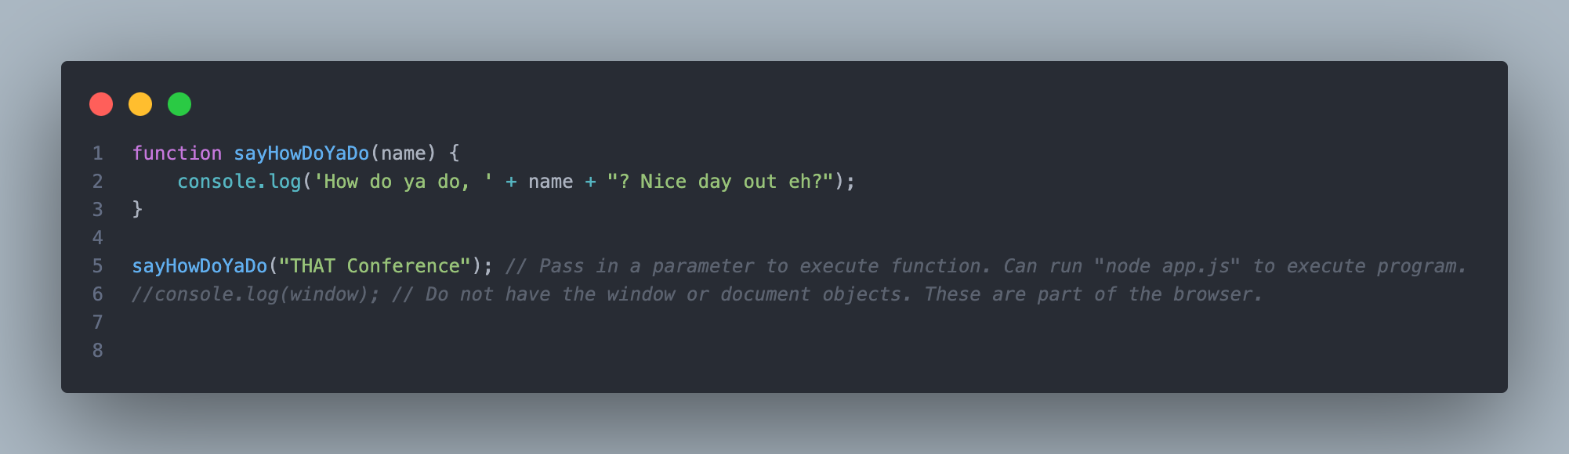
Simple Node.js Program
You can download Node.js from a browser
Search “Download Node.js”
Select operating system for download
sayHowDoYaDo() function code example (terminal)
Notes:
To download Node.js, you can navigate to the Node.js website (https://nodejs.org/en/download/package-manager)
Select the operating system (the OS of your system) before download Node.js (macOS, Windows, Linux, etc.)
Usually, best practice to download the latest stable version of Node.js (LTS). Can view the documentation on the versions, look at the change logs, and look at any breaking changes.
After you follow the installation instructions, can run ”node --version” on your command prompt to verify that you have installed Node.js. Can also use this command to check the version of Node.js you have.
npm is installed automatically with Node.js.
To check the version of npm, run “npm --version”.
CODE EXAMPLE: “1.-NodeJS-Example-SimpleHello” (Just run this code regularly) – the code for this example is in an app.js file.
Make sure you are in the correct folder for running the code in Visual Studio Code!

Slide 9
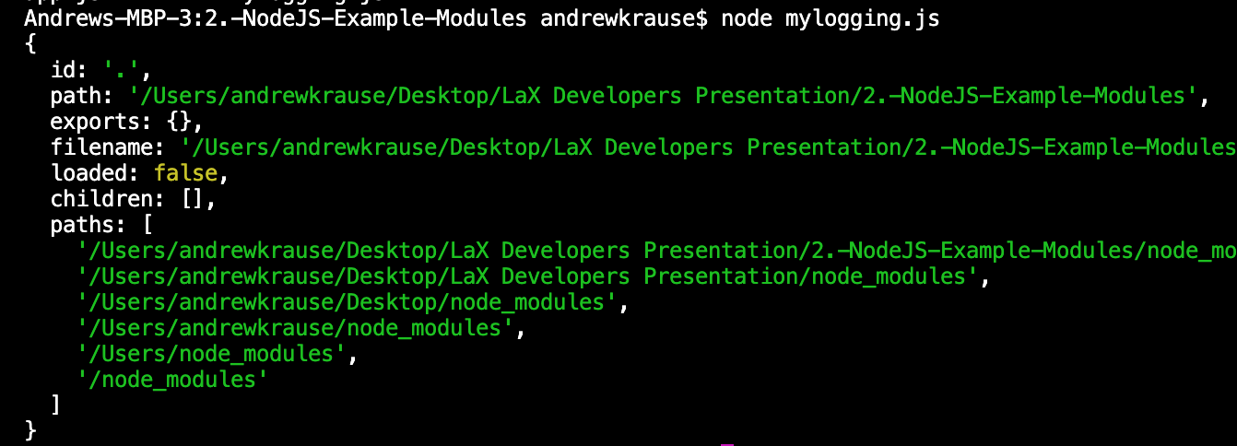
Node.js Modules Overview
Good design to split our JavaScript files up - modules
Result of console.log(module) in mylogging.js example file.
Some Node.js Built-In Modules: os, fs, events, http
Notes:
The image above is a result of running console.log(module). Node.js represents modules as objects with specific properties. If you log “module” you will get information on the properties of that object defined by Node.js. Here are what the properties are below.
id: The identifier of the module, which is the absolute path to the file.
path: The directory path where the module is located.
exports: An object that will hold the module's exported functions or variables. Initially empty.
filename: The absolute path to the module file.
loaded: A boolean indicating if the module has been loaded. Initially false.
children: An array containing the module objects of the child modules required by this module. Initially empty.
paths: An array of directory paths where Node.js looks for modules when they are required.
This information is part of the Module object in Node.js, which helps in module resolution and loading.
Modules – What are they and why use them: Reusable building blocks of our application.
To build reliable and maintainable applications, we instead want modularity to avoid overwrites.
Instead, we want to use modularity, which is small, reusable building blocks/chunks of code.
We want modules or small building blocks where we define our functions and variables.
That way two functions or variables with the same name do not overwrite each other.
Adheres to the DRY principle (“Don’t Repeat Yourself”)
Module Details: They are a core of Node.js
Every file in a node application is considered a module. Variables and functions defined in that file are scoped to it (in Object-Oriented programming terms, we would say they are private to that file/container).
To access the variables and functions in the file outside of the file/module, we need to export it (we make it public).
We can import the file elsewhere and then use the functions and variables wherever we imported it.
Every Node.js application typically has a main module or main file like app.js.
CODE EXAMPLE: “2.-NodeJS-Example-Modules” (Run in Debug Mode to Step Through) → (Talk about global objects first below)
Make sure you are in the correct folder for running the code in Visual Studio Code!
KEEP FOR NOW, BUT DO NOT PRESENT ON THIS AT THE MOMENT:
Global objects – meaning we can access them anywhere. Can be used in browser and in Node.js
Examples:
console.log() – log information to the console
setTimeout() – cause a delay
clearTimeout() – stop the delay
setInterval() – repetitively call a function after a given delay
clearInterval() – Stop function from being called repetitively
window is recognized in the browser, but not by the Node.js runtime
We cannot add our own variables and functions to the Node.js global object.
Avoid defining functions and variables in the global scope. Why? Because to build reliable and maintainable applications, we instead want modularity to avoid overwrites.

Slide 10
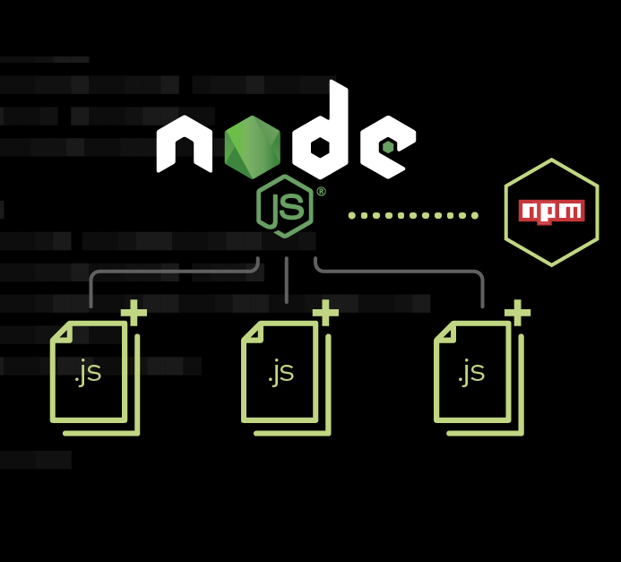
Node.js: Built-In Modules
Path (path)
OS (os)
File System (fs)
Events (events)
HTTP (http)
See Node.js docs for more details
Notes:
Node.js has built-in modules you can utilize once you download Node.js. Ideal to visit the Node.js docs and see what kinds of built-in modules it has/
Link to Node.js docs where you can view some of its built-in modules: https://nodejs.org/docs/latest/api/
W3 Schools also has information on different Node.js modules: https://www.w3schools.com/nodejs/nodejs_modules.asp
We will see how some of the built in modules work and what they can be used for in the code example (below - VS Code and VS Code’s Terminal)
Below are some commonly used built-in Node.js modules. There are many more built-in modules that you can explore in the Node.js docs as well.
Path (path) – module that provides a way of working with directories and various file paths.
OS (os) – module that provides a way of getting info about a computer’s operating system.
File System (fs) – module that allows you to work with the file system on your computer (files, directories, etc.). Can read files and directories, write to files, etc.
Events (events) – Every action on a computer is an event (connection made or file being opened). This module allows you to work with events (firing events and listening for events).
More details on this module in the next slides.
HTTP (http) – module that allows Node.js to transfer data over the Hyper Text Transfer Protocol. Can create a HTTP server that listens on a port and gives a response back to the client.
More details on this module on the next slides.
Code example 3 (below) uses an event callback.
A callback function is a function that is executed after another function finishes execution.
It is a function that is passed into another function as a parameter so it can be executed in that function.
CODE EXAMPLE: “3.-NodeJS-Example-BuiltInModules” (Run in Debug Mode to Step Through)
Make sure you are in the correct folder for running the code in Visual Studio Code!

Slide 11
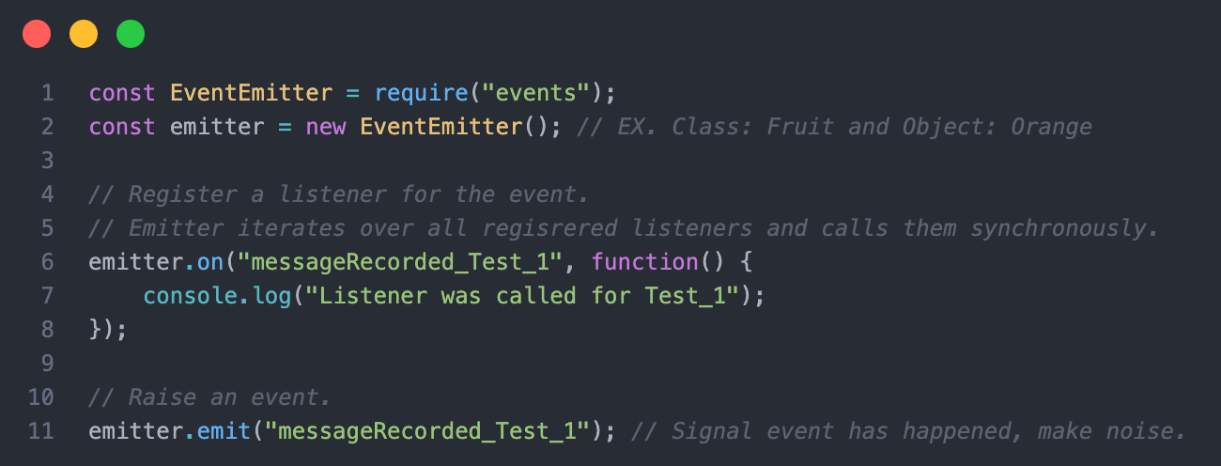
Node.js: Events Module
Event: Signal that something happened
Notes:
A lot of Node.js’s core functionality is based on events.
An event is a signal that something happened.
Node.js has modules that allow us to generate events, listen for events, and handle events. One such module is the events module.
Events module:
The “events” module is assigned to a class (called EventEmitter class) because it can create objects that emit those events and handle those events with event listeners.
Some modules require assignment to JavaScript classes, and others do not. I think it depends on usage. When in doubt, reference the docs for the built-in modules.
For the events module, it is assigned to a class so you can have multiple independent instances of event emitters.
Node.js Docs on Events module: https://nodejs.org/docs/latest/api/events.html#emitteremiteventname-args
CODE EXAMPLE: “4.-NodeJS-Example-EventsModule” (Run in Debug Mode to Step Through)
Make sure you are in the correct folder for running the code in Visual Studio Code!

Slide 12
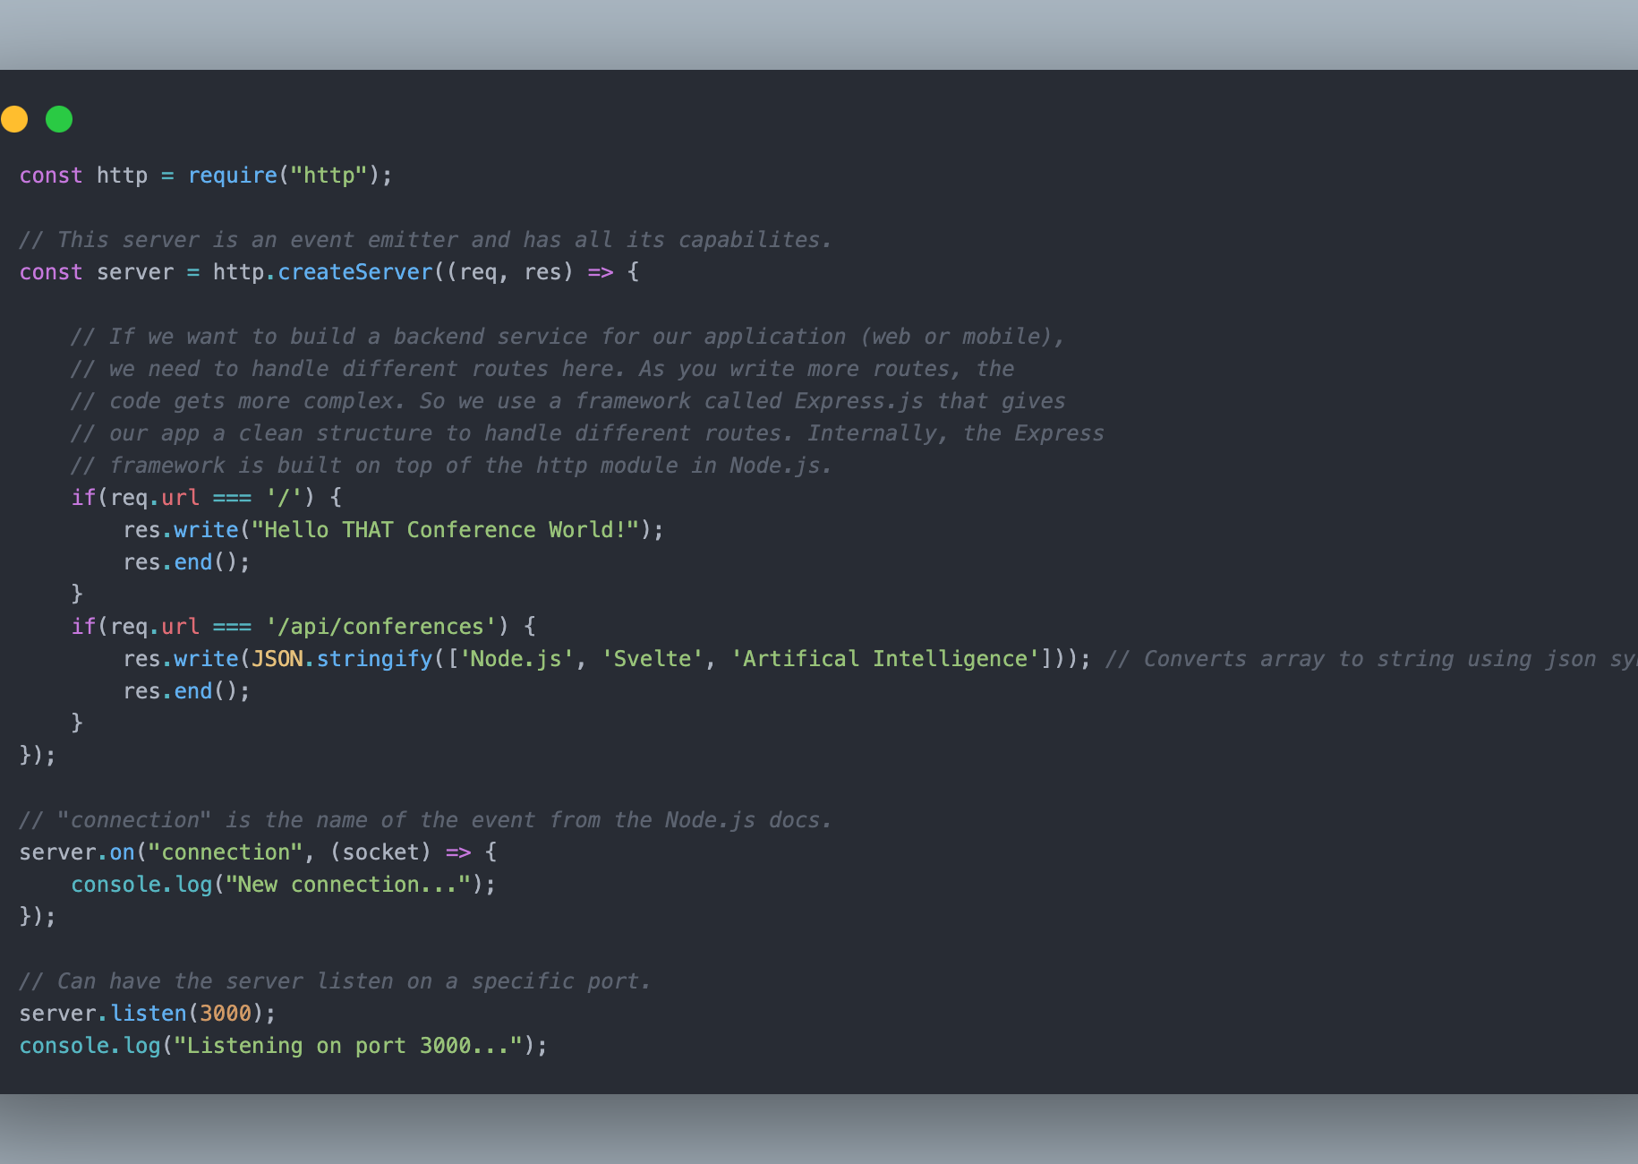
Node.js: Http Module
Can create a web server to listen on a port
Notes:
In Node, we have a module called HTTP that we can use to help build a web server.
We listen on a given port. Every time we receive a request on that port, the HTTP class raises an event.
Our job is to respond to that event which involves reading the request and returning the correct response.
In the example shown on the image above (and we will run this example), each time a user accesses the server on port 3000, the event listener (”on” function) handles that event and prints out a message.
Depending on your code, you might be interested in responding to those events.
The HTTP module is used with networking applications.
Can create a web server that listens for http requests on a given port
With module, we can create a backend service for our client applications.
Ex. A client app that we build with React or Angular. Or a mobile app!
In the HTTP module (in the Node.js docs), there are different properties, methods, and events.
Worth noting that the difference between the built-in HTTP module and the Express.js npm module:
The HTTP module is a low-level framework for creating servers
The Express.js npm module is a high-level framework for creating servers. It is also built on top of the HTTP module.
CODE EXAMPLE: “5.-NodeJS-Example-HttpModule” (Run in Debug Mode to Step Through)
Make sure you are in the correct folder for running the code in Visual Studio Code!

Slide 13

Node.js: npm
Node.js’s built-in package manager
Developers create reusable modules, share via npm
Don’t have to reinvent the wheel
Notes:
npm – node package manager: https://www.npmjs.com/
Software registry (library) containing code packages from third parties
Provides thousands of packages for us to use in our applications
Difference between npm and the core Node modules is that npm packages are Node modules created by third parties
Packages ranked by popularity and reliability
npm init – results in creation of package.json file; this is what npm reads to know what to install for an application; saves space so you don’t have to transfer all downloaded packages with your project
Don’t need to reinvent the wheel in certain cases!
Popular npm packages include:
Lodash (JS Library, simplifes arrays, objects, strings, etc.)
Axios (Http Client Framework)
Molecular (Microservices Library)
Express (Express.js is one of the simplest and fastest Node.js web frameworks; based on core Node modules like the Events and the Http module)
Important tips when considering using a npm package below:
Use packages from trusted sources: Make sure you are using packages from reputable sources, such as well-established and widely-used packages, or packages that have been recommended by trusted developers.
Good question to ask is: How long has the given npm package/module been around? For example, Express.js has been around since 2010, which was an earlier time for Node.js.
Keep packages up-to-date, otherwise you risk security vulnerabilities. Use a tool like NPM audit to check for known vulnerabilities in your packages and take steps to address any issues that are found.
Be aware of the permissions that a package is requesting, and only install packages that have the minimum permissions required for your application.
Before installing a package, read the documentation to understand what it does and whether it is suitable for your project.

Slide 14
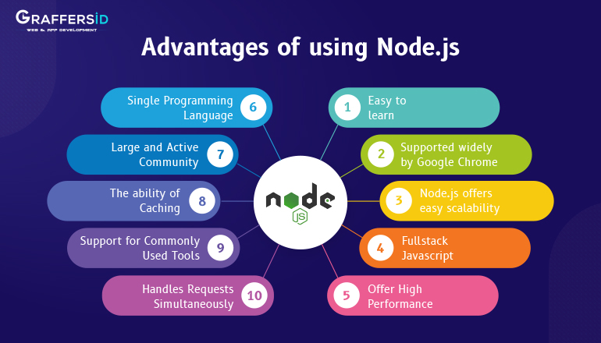
Notes:
Widely used backend framework. With npm modules like Express.js, you can learn how to create a simple server fairly quickly.
Examples of how Node.js can be used (we talked about this near the start of the presentation, but here are more examples):
Data-intensive and real-time apps
Superfast and highly scalable
JavaScript
You can have a cleaner and more consistent codebase with a single language for the frontend and backend
Large ecosystem of open-source libraries – can focus on core of application instead of creating building blocks from scratch
Powerful ecosystem – one of the largest ecosystems of open-source libraries available to you (npm)
Strong corporate support
Large community, easier to learn
Microservices – I have not done much with this
Distributed networks
Single language for frontend + backend
JavaScript still popular today – or at least still widely used (about 64% of programmers use JS as of 2023): https://www.statista.com/statistics/793628/worldwide-developer-survey-most-used-languages/
Top 6 Reasons You Should Learn Node.js (2024): https://zerotomastery.io/blog/should-I-learn-node-js/
Most popular web frameworks in 2024: https://radixweb.com/blog/best-backend-frameworks

Slide 15
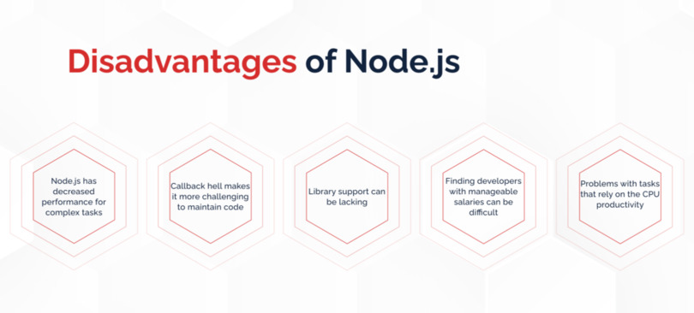
https://radixweb.com/blog/best-backend-frameworks
Notes:
Node.js is used to run JavaScript. Not everyone is a fan of JavaScript, which is understandable. The following are reasons people do not like JS:
Automatic type conversion (coercion) – interpreter automatically converts one data type to another.
Can use Typescript to have JS with types, but that is a whole other language you need to learn on top of JS. Some developers do not like that.
Interpreted vs Compiled language – you do not always know about the errors in JavaScript until runtime
JavaScript has two special values to represent no values: null and undefined
undefined – no variable assigned
null – intentionally empty
JavaScript does not use classes – just syntactic “sugar” over constructor functions
JS uses prototypical inheritance
Module system in JavaScript
JS was not originally designed for large-scale applications
JS has different module systems, and each module system has their own syntax. Therefore, we may need to translate between module systems. This adds a layer of complexity that can be hard to understand at times.
CommonJS, ES6 Modules (ESM), UMD (Universal Module Definition), and AMD (Asynchronous Module Definition)
Callback hell / the Pyramid of Doom. Solutions to help with nested/complex callbacks is to use async/await as alternatives to callbacks.
A callback function is a function that is executed after another function finishes execution.
Node.js and NPM
Library support can be lacking for certain modules and npm packages.
Certain npm packages could be a security issue because npm is comprised of third parties who may sometimes publish packages that are intentionally or unintentionally insecure.
Despite the drawbacks, JavaScript is not going anywhere for a very long time – it is everywhere. It runs on the web and on servers (thanks to Node.js).
Therefore, it is reasonable to assume that Node.js will also be around for quite some time.
Node.js may be worth looking into becoming more familiar with it especially in terms of web development.
You can get nice paying jobs if you understand JavaScript well. It is a nice tool to have in your programmer toolbelt.

Slide 16

Companies that Use or have Used Node.js
Notes:
Companies that use or have used Node.js:
Companies that use Node.js see it as an ideal choice for building highly scalable services.
A lot of the uses involve improving user experience and scalability.
See more details on companies below.
PayPal (only example where you list out more details - can access link for more info on how companies have used Node.js if needed)
Used Node.js to build out one of their applications
Built the application twice as fast with fewer people
33% fewer lines of code
40% fewer files
2x request/sec
35% faster response time
Source for this information: https://inoxoft.com/blog/which-companies-use-nodejs-and-why-they-do-that/
Uber
LinkedIn
Google Cloud
eBay
Netflix
Trello
NASA
Twitter / X
Walmart
Groupon

Slide 17

Questions?
Notes:
Any questions or comments? Anything you think is worth sharing about Node.js that you may already know?

Slide 18

Useful Node.js Resources: Websites and Learning Platforms
Node.js Download and Docs: https://nodejs.org/en
npm Docs: https://www.npmjs.com/
Code with Mosh: https://codewithmosh.com/
Udemy: https://www.udemy.com/
LinkedIn: https://www.linkedin.com/company/node-js/
Notes:
Node.js Website: https://nodejs.org/en
Node.js GitHub Repository: https://github.com/nodejs/node
NodeSchool.io: https://nodeschool.io/
FreeCodeCamp: https://www.freecodecamp.org/
Udemy: https://www.udemy.com/
LinkedIn: https://www.linkedin.com/company/node-js/
Reddit: https://www.reddit.com/r/node/
The App Brewery: https://appbrewery.com/courses/430756/lectures/6707408
CodeSandbox: https://codesandbox.io/signin?continue=/dashboard/home

Slide 19

Useful Node.js Resources: Books, Blogs, Videos
Book - “Learning Node.js Development” by Andrew Mead
Blog - Node Weekly
Video – Node.js: The Documentary
Course – Node.js Tutorial for Beginners: Learn Node in 1 Hour (Code with Mosh)
Course - Udemy Web Development Bootcamp (Dr. Angela Yu)
Notes:
Can give the developers links to the sources listed above if they are curious.
Book - “Learning Node.js Development” by Andrew Mead
Blog - Node Weekly: https://nodeweekly.com/
Video - Node.js: The Documentary: https://www.youtube.com/watch?v=LB8KwiiUGy0
Course - Node.js Tutorial for Beginners: Learn Node in 1 Hour (Code with Mosh): https://www.youtube.com/watch?v=TlB_eWDSMt4&t=921s
Course - Udemy Web Development Bootcamp: https://www.udemy.com/course/the-complete-web-development-bootcamp/?couponCode=LETSLEARNNOWPP

Slide 20
Presentation Sources
Picture of Coffee Shop: https://www.shutterstock.com/search/barista-making-coffee
Picture of Node.js Modules: https://developers.redhat.com/blog/2021/02/10/add-standardized-support-information-to-your-node-js-modules
Picture of Node.js Advantages: https://graffersid.com/node-js-advantages-and-disadvantages/
Picture of Node.js Disadvantages: https://keenethics.com/blog/what-are-the-advantages-of-node-js
Picture of Companies that use Node.js: https://appdeskservices.com/companies-that-use-nodejs/
Questions Slide Picture: https://www.bairesdev.com/blog/node-js-interview-questions/
The Man Who Broke the Internet Pictures: https://medium.com/@harshitgambhir88/the-man-who-accidentally-broke-the-internet-by-deleting-11-lines-of-code-e0fa8d995171#:~:text=In%20March%20of%202016%2C%20A,Ko%C3%A7ulu%20accidentally%20broke%20the%20internet.
Notes:
Can just skip right past this slide.

Slide 21




My Info
Personal Website: https://andrewkrause.dev
GitHub: https://github.com/Andrew-EKrause
Gravatar Profile: https://gravatar.com/aekkrause
Email: aek.krause@gmail.com
Notes:
You can access my LinkedIn, GitHub, Personal Website, and TravelBlog project through my Gravatar Profile as well

Slide 22
Thank you!
Notes:
If you know more about Node.js and have anything to share, I would love to learn more from you!

